Slide 1
Estimating Camber, Deflection, and Prestress Losses in Precast, Prestressed Bridge Girders, TRC 1606
Ahmed Al-Mohammedi
Micah Hale

Slide 2
Acknowledgements
Ahmed Al Mohammedi, Graduate Student
Bryan Casillas, Graduate Student
Rick Stanley, ARDOT
Chris McKenney, ARDOT
Patrick Stevens, BGE
Kip Guthrie, BGE
Neil Drews, Coreslab Structures, Tulsa, OK
Pam Gullett, JJ Ferguson Prestress Precast, Greenwood, MS

Slide 4
Background
The current design methods results in differences between the design and the actual camber.
Excessive camber makes the girder top flanges interfere with the deck thickness and reinforcement, while insufficient camber increases the deck thickness can add extra weight and load on the girders.
These result in :
Cost increase.
Project delay.
Reduce the ride quality of bridges.
Construction problems.

Slide 5
Background
The main goal of this project is to improve the accuracy of estimating camber and long-term deflection in precast prestressed concrete girders
Current Methods for Camber Prediction:
1.80 × initial camber – 1.85 × deflection = camber at erection
2.45 × initial camber – 2.70 × deflection – (others) = final camber
(2) Underestimation of concrete properties.
(3) Inaccurate prediction of strands stress.
Why does the design camber not equal the actual camber?

Slide 6
Background
Tension the strand to approximately 0.75f_{pu}
Dead End
Live End
Cast the concrete
Prestressing Chuck
Prestressing Chuck

Slide 7
Background
If the concrete strength is low, then there can be cracking in the end regions, excessive camber, and an increase in prestress losses.
The tension force in the strands is now transferred to the concrete. This puts the concrete in compression and the beam shortens.
Approximately 18 to 24 hours after casting and the concrete has reached sufficient strength, the strands are cut.
Dead End
Live End

Slide 8
Background
Dead End
Live End
Camber

Slide 9
Background
What are some factors that effect camber?
Concrete strength/modulus of elasticity. Concrete strength/modulus increases with time. Camber decreases as E increases.
Section size (self weight) and section properties (moment of inertia). Larger sections have less camber.
e
P
The prestress force. Larger prestress force, more camber. The prestress force decreases over time (prestress losses).
Camber
Additional dead load decreases camber.
Eccentricity. Larger “e”, larger moment and more camber

Slide 10
Background
All camber/deflection calculations are estimates
Affected by uncertainties relating to material properties
Time dependent
Temperature
Humidity
Load application

Slide 11
Research Plan
Several visits were made to two plants which are: (1) Coreslab Structures in Tulsa, OK (2) JJ Ferguson Prestress/Precast in Greenwood, MS.
The objectives from these visits are to:
Evaluate concrete properties.
Measure strand stress.
Monitor camber in the field.
Evaluate the current design methods.

Slide 12
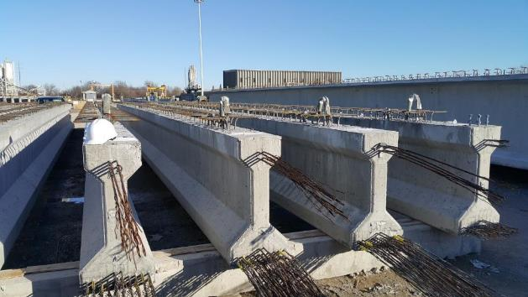
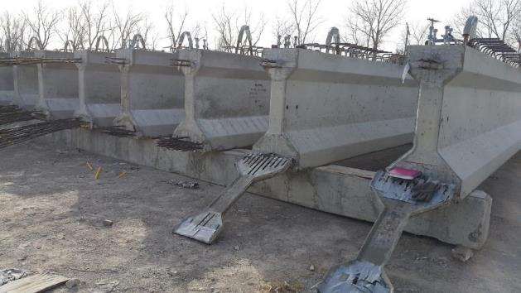
Type II
Coreslab Structures Tulsa, OK
Nine AASHTO girders were instrumented at two precasting plants (Tulsa, OK & Greenwood, MS):
Two Type II Girders
Length = 42ft
Strands = 10 - 1/2 in. Ø
Two Type III Girders were instrumented.
Length = 63ft
Strands = 26 - 1/2 in. Ø
Type III
Girders are for the job No. CA0901 HWY. 264 – over New Hope Rd. & Blossom Way CR. Benton County, Rogers, AR
Coreslab Structures Tulsa, OK

Slide 13
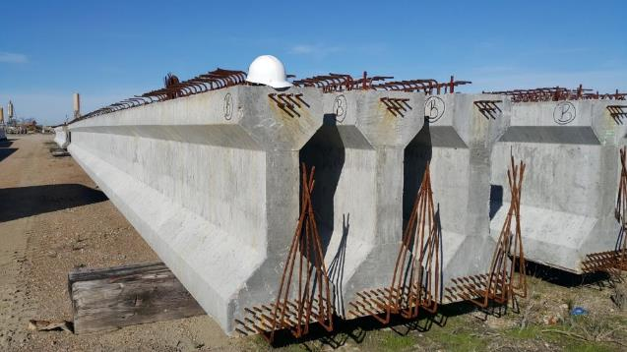
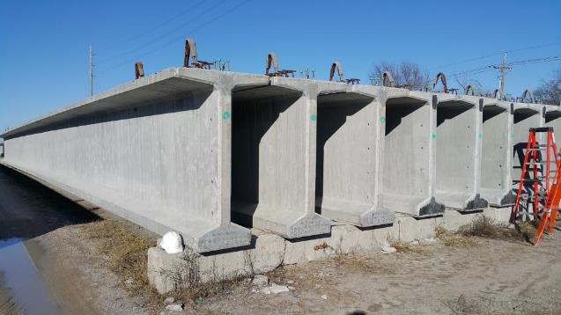
Type IV
J J Ferguson Prestress/Precast Greenwood, MS.
Two Type IV Girders
Length = 91ft
Strands = 38 - 1/2 in. Ø
Type IV girders are for the Job No. 070282 Hwy 167 in south Arkansas over the Ouachita River, Calion, AR.
Three Type VI Girders
Length = 109ft
Strands = 38 - 1/2 in. Ø
Type VI
Coreslab Structures
Tulsa, OK
Type VI girders are for job Number CA0907 HWY.112 - I-49 (S), Benton County, Rogers, AR.

Slide 14
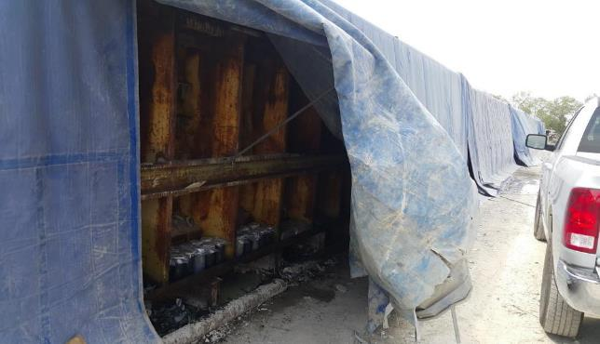
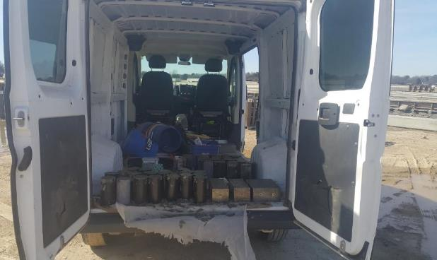
Evaluating Concrete Properties
Concrete was sampled during the casting of each girder. More than 30 cylinders and 6 prisms were cast from each mix. The specimens were brought to the lab the following day and tested for:
1- Compressive strength. 2- Elastic modulus. 3- Unit weight. 4- Creep. 5- Shrinkage.
Coreslab Structure Plant Tulsa, OK
JJ Ferguson Plant Greenwood, MS

Slide 15
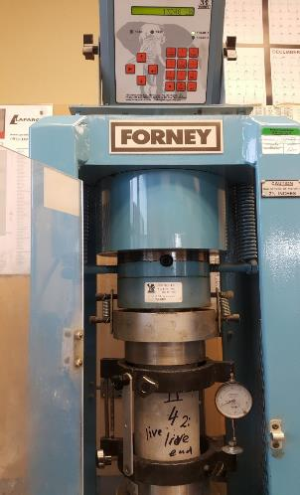
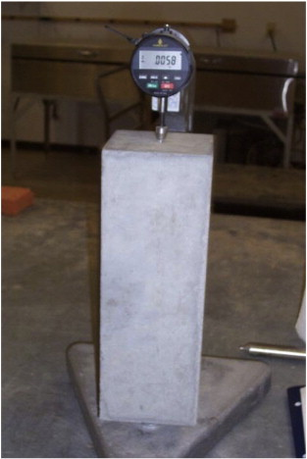
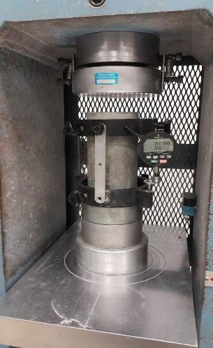
Evaluating Concrete Properties
Modulus of Elasticity test at JJ Ferguson lab
Modulus of Elasticity test
Creep test
Shrinkage test

Slide 16
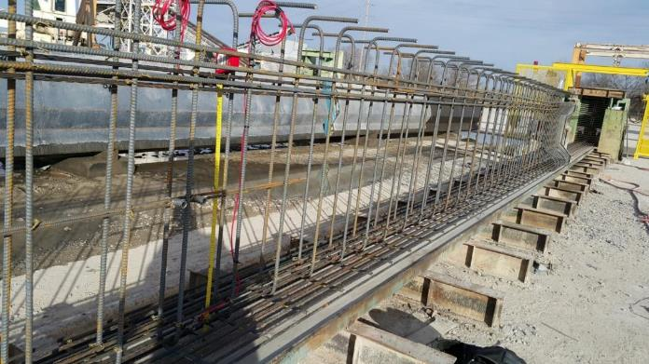
Strand Stress
The force in the prestressing strands affect prediction of the camber.
Vibrating Wire Strand Gauges (VWSG) were used to measure the strands stress.
Two gauges were used in each girders. A total of nine girders were instrumented.
VWSG in the top strands.
VWSG locations

Slide 17
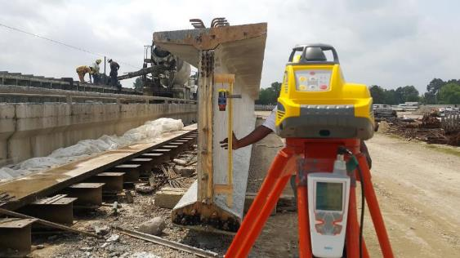
Monitoring camber
Measuring the erection camber using laser level
The initial camber was measured immediately after release while the girders were still on the prestressing bed and again immediately after moving the girder to storage yard.
Camber was measured multiple times until the girders were shipped to the job site.
Once the girders arrived to the bridge site, camber was measured before and after casting the deck.
Laser level
Laser receiver
Humidity and temperature recorder

Slide 18
Compressive Strength Results
Δ = Pel²/(8E_{ci}I)
L = 42 ft, P = 10(190 ksi)(0.153 in²) = 290.7 k
I = 50,980 in4, e = 13.33 in.
Current Methods for Camber Prediction:
1.80 × initial camber – 1.85 × deflection = camber at erection
2.45 × initial camber – 2.70 × deflection – (others) = final camber
Δ = Pel²/(8E_{ci}I)
L = 109 ft, P = 38(190 ksi)(0.153 in²) = 1105 k
I = 733,320 in4, e = 33 in.
Precasters want the concrete to gain the required release strength in a short period of time in order to cut the strands, move the girder, and start preparing to cast another girder.
The measured compressive strength at release was 27% to as much as 73% higher than the design strength.
Δ = 0.63 in.
Δ = 0.45 in.
E_{c} = 57,000√f’_{c}
Δ = 2.41 in.
Δ = 2.14 in.
E_{c} = 57,000√4500 = 3820 ksi
E_{c} = 57,000√8650 = 5300 ksi

Slide 19
Modulus of Elasticity
The ACI 363 equation and the AASHTO LRFD equation underestimated the modulus of elasticity of concrete by 15% to 20%.
Modification factors are proposed in the final report to overcome the underestimation.
ACI 363-14
Predicted versus measured E at release
2014 AASHTO LRFD

Slide 20
Measured vs Designed Camber:

Slide 21
Camber at Erection - Summary

Slide 22
Recommended Changes to Camber Equations
The recommended method utilizes a single multiplier of 1.4 times the elastic camber (initial camber at release) calculated using gross section properties as shown in the equation below. This multiplier was validated using the camber measurements conducted at girders erection.
Current Methods for Camber Prediction:
1.80 × initial camber – 1.85 × deflection = camber at erection
2.45 × initial camber – 2.70 × deflection – (others) = final camber
1.4

Slide 23
Recommended Changes to Camber Equations

Slide 24
Prestress Losses
For Type VI girders, the measured prestress losses before deck placement was 34% less than the expected.
The high compressive strength at release also affects modulus of elasticity.
The measured elastic shortening losses was very close to the predicted when using transformed section properties.

Slide 25
Results
The measured total prestress losses were 146% and 86% less than the design losses calculated by the 2014 AASHTO refined method
The high compressive strength at release decreased the prestress losses.
Elastic shortening losses can be accurately estimated by applying the prestressing force directly to the transformed section properties.

Slide 26
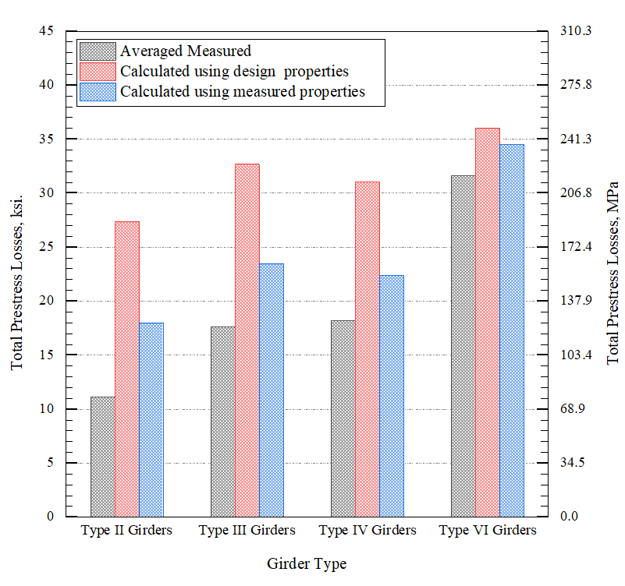
Predicted vs Measured Total Prestress Losses
As shown in the percent differences between the measured and predicted prestress losses at the time of deck placement is 146%, 86%, 71%, and 14% for AASHTO Type II, III, IV, and VI girders, respectively.

Slide 27
Recommended Changes to Modulus of Elasticity Equations
The MOE of concrete is a significant parameter in determining the initial camber and deflection of prestressed concrete girders.
MOE of concrete at release is necessary for estimating both downward and upward defection components of initial camber.
MOE at service is more important for quantifying the downward component which directly affects the long-term deflection.
Deflection due to girder self weight
∆= $\frac{5 w l^4}{384Ei I}$
Camber due to prestressing force
∆= $\frac{P e l}{8EI}$

Slide 28
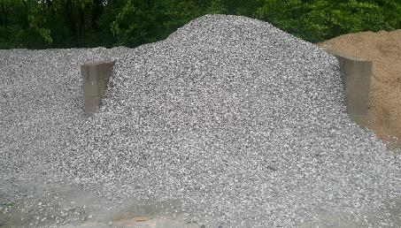
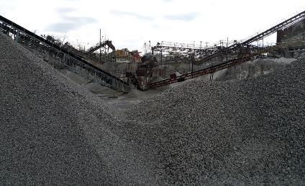
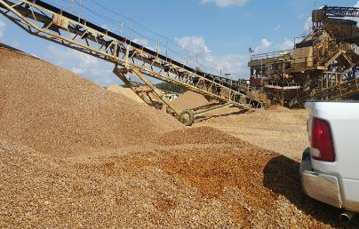
Coarse Aggregate Stiffness Coefficient (K1)
The type and the stiffness of the coarse aggregate affect the modulus of elasticity of concrete. This effect is accounted for by the K1 Coefficient as shown in the equation below:
E = 33 $W^{1.5}\text{K}\text{1}\sqrt{f^{′}c}$ .………………………………....AASHTO LRFD (2012)
ERC Lab
Tulsa, OK
Greenwood, MS

Slide 29
Coarse Aggregate Stiffness Coefficient (K1)

Slide 30
Coarse Aggregate Stiffness Coefficient (K1)

Slide 31
Coarse Aggregate Stiffness Coefficient (K1)

Slide 32
Coarse Aggregate Stiffness Coefficient (K1)
The AASHTO LRFD (2014) gives a better estimate for the modulus of elasticity when the concrete compressive strength is higher than 6500 psi. Therefore, it was more realistic to derive two K₁ coefficients with a range of applicability below and above 6500 psi. K₁ coefficients are summarized in the table below.
Range of Applicability | Crushed limestone (Sulphur Springs, AR ) | River Gravel (Greenwood, MS) | Crushed limestone (Springdale, AR)
f'_{c} < 6.5 ksi | 1.15 | 1.20 | 1.10
f'_{c} > 6.5 ksi | 1.05 | 1.10 | 1.00

Slide 33
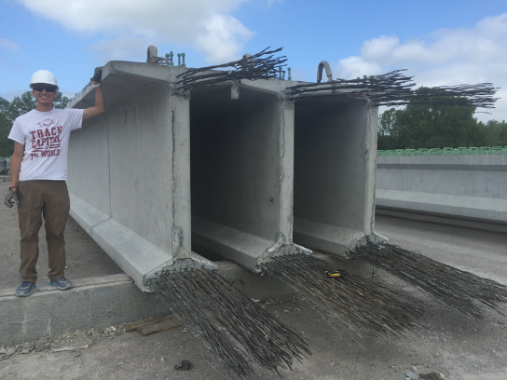
Conclusions
Use measured compressive strengths
Instead of specified
Measured release strength were 26 to 80% higher than design strength
Use a multiplier of 1.4 vs 2.45 for final camber
Measure Modulus of Elasticity
Use recommended K1 values
Measured E’s at release were 20% to 50% greater than design

Slide 34
Recommendations
Concrete compressive strength should be taken as:
7.2 ksi. at release when the specified compressive strength at release is less than 7.0 ksi.
10% higher than the specified compressive strength at release when the specified compressive strength at release is equal or greater than 7.0 ksi.
The current ARDOT bridge design specification should be adjusted to specify the 28th day concrete compressive strength 50% higher than the design compressive strength at release.
When estimating the initial camber at release camber, use the transformed section properties.

Slide 35
Questions?
micah@uark.edu

